Slide 1
Scientific Research Method: Data Analysis, Interpretation & Presentation
CSC 4195 Research Methodology
9
5
FALL 2020-2021
Dr. Afroza Nahar, Associate Professor,
Department of Computer Science, Faculty of Science & Technology.
afroza@aiub.edu

Slide 2
Data Analysis
Data analysis is a process of inspecting, cleansing, transforming, and modelling data with the goal of discovering useful information, suggesting conclusions, and supporting decision-making.

Slide 3
Data Analysis
The purpose of analysing data is to obtain usable and useful information by extracting the meaning from systematically collected measurements.
Data analysis may:
describe and summarize the data
Identify and describe patterns in large amounts of data
Identify relationship between variables
Compare variables
Identify the differences between variables
Display data in graphs, tables, maps, etc.
Forecast outcomes

Slide 4
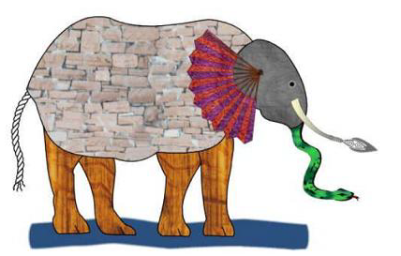
Blind Men and an Elephant

Slide 5
The Blind men and an elephant is an idiom. The story of the blind men and an elephant comes from India. It is about a range of truths and mistakes. It is also about the need for communication and the need for respect for different perspectives. The idiom shows the effects of observation and bias.

Slide 6
Common Myths
Myths
Reality
Complex analysis and big words impress people
Analysis comes at the end after all data are collected
Quantitative analysis is the most accurate type of data analysis
Data have their own meaning
Stating limitations to the analysis weakens the evaluation
Computer analysis is always easier and better
Most people appreciate practical and understandable analysis
We think about analysis upfront so that we have the data we want to analyse
It is the quality of the analysis process that matters
Data must be interpreted; mere numbers don’t bear any meaning
All analyses have weaknesses, it is honest and responsible to acknowledge them
It depends on the size of the data set and personal competencies.

Slide 7
Organizing the Data
Organize all forms/questionnaires in one place
Check for completeness and accuracy
Remove those that are incomplete or do not make sense – keep a record of your decisions
Assign a unique identifier to each forms/questionnaire

Slide 8
Data Entry
By hand
By computer
MS Excel (spreadsheet)
MS Access (database mgt)
SPSS (quantitative analysis; statistical software)
Statistical Record
Count (frequencies)
Percentage
Mean
Mode
Median
Standard deviation
Variance
Ranking
Cross tabulation

Slide 9
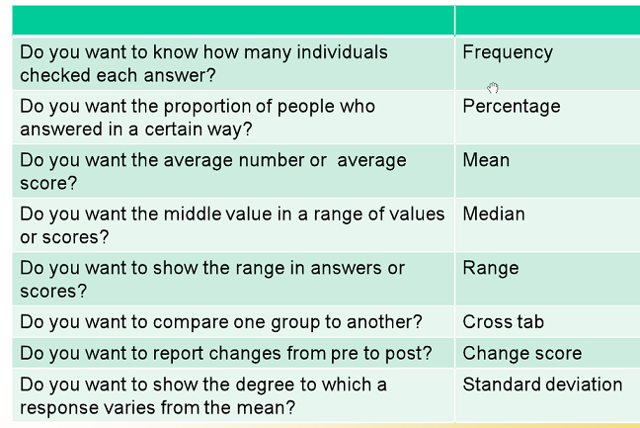
Which calculation is Required?

Slide 10
General Data Analysis
Relationship forms:
Linear
Positive & negative
Correlation coefficient
Regression analysis
Criterion & predictor variables
Error of prediction
Monotonic
Non-linear

Slide 11
Data Presentation/Display
A graphical technique for communication and analysis that depicts data patterns rather than literally describing them.
Allows relevant properties of phenomena to be highlighted and clarified.
Used by scientists for several purposes including:
Initial data examination
Interpret the meaning of data
Communicate data and meaning to others.

Slide 12
Displaying data ...
The design and use of data displays boil down to one underlying idea:
Effective Communication!
Clear
Accurate
Unambiguous
Efficient
Aesthetically Pleasing

Slide 13
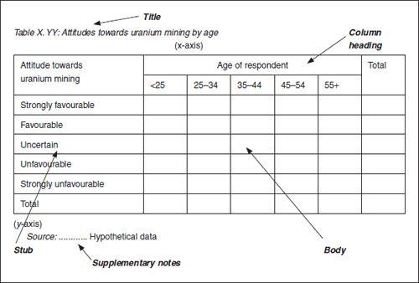
Displaying data : Tables
Organized lists, arrays or matrices of data
Show data values directly in numbers
Minimal use of spatiality

Slide 14
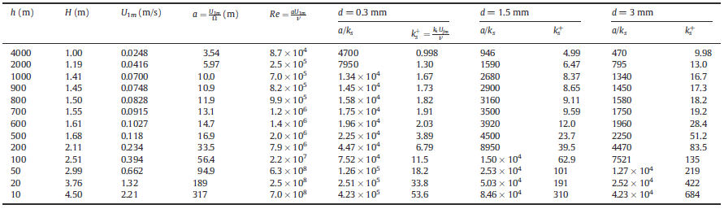
Example of a Table

Slide 15
Displaying data : Graphs
Pictorial representations of data.
The use of spatial properties such as:
Location
Size
Distance
Direction
3 rules to follow :
Label Clearly and Sufficiently
Avoid Uninformative and Content-Free Graphic Marks
Fill the Graph Space with Data Marks

Slide 16
Displaying data : Graphs…
Always plot discrete points clearly.
Do not join points unless you have a continuous mathematical function.
Compare data plot several lines on the same axes.
Consider including error bars on all points

Slide 17
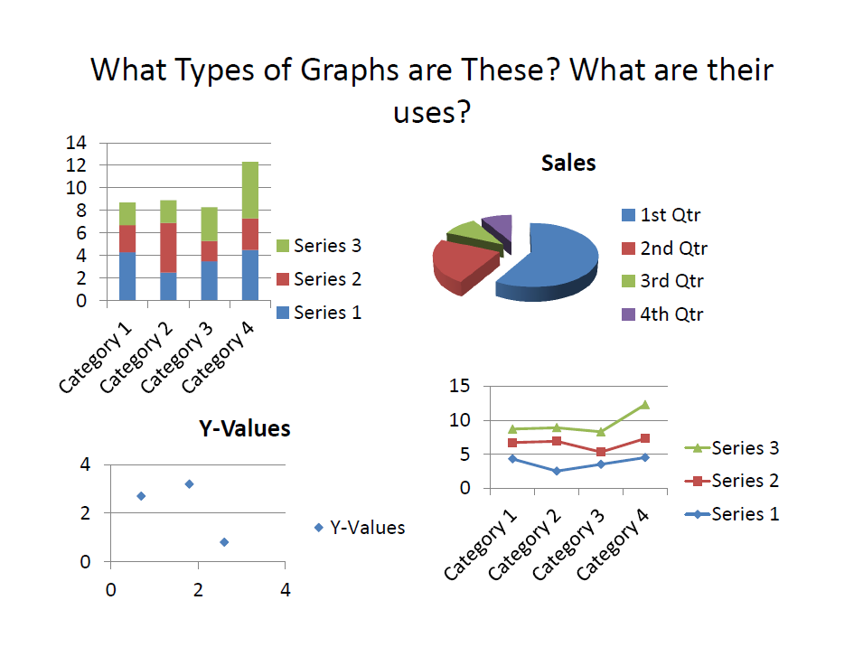
Types of Graphs

Slide 18
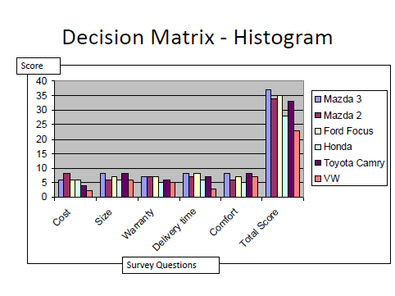
Types of Graphs

Slide 19
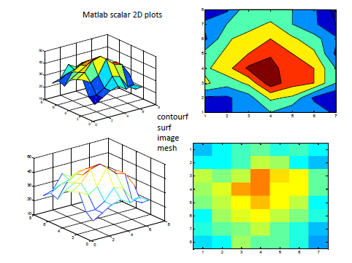
Types of Graphs

Slide 20
Displaying data : Map
Maps are graphical displays that depict earth-referenced features and data.
Reference Maps:
Depict actual earth surface features as accurately as possible
Locations are encoded with a coordinate system
Thematic Maps
Special purpose displays
Hybrid “map-graph” that uses geographic space as a base

Slide 21
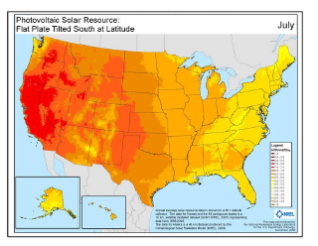
Displaying data : Map

Slide 22
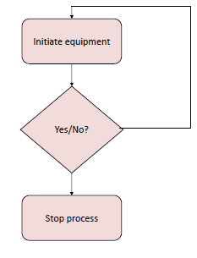
Flow Charts
A series of steps to accomplish a task
Normally used in software development

Slide 23
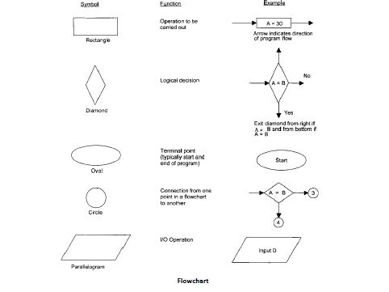
Flow Charts

Slide 24
Symbol with name Function Example
Rectangle
Operation to be carried out
A = 30
Process
Arrow indicates direction of the program flow
Diamond
Logical decision
A = B
No
Decision
Yes
circle
Connection from one part in a flow chart to another part
Exit diamond from right if A = B and from bottom of A = B
Start
Oval
Terminal point (typically start and End of program
A = B
3
Parallelogram
I/O operation
4
Input O

Slide 25
Interpreting the Information
Numbers do not speak for themselves.
Interpretation is the process of attaching meaning to the data
Interpretation demands fair and careful judgements. Often the same data can be interpreted in different ways.
Hence, it is helpful to involve others or take time to hear how different people interpret the same data ... hold a meeting for example

Slide 26
Interpreting the Information…
Part of interpreting information is identifying the lessons learned. Ask the following questions:
What did you learn?
What is new? What was expected?
Are the findings surprise you?
Are there things you do not understand well?
Is further study needed for more clarification?
Often recommendation or action plan is included with interpretations

Slide 27
Interpreting the Information…
Ethical guidelines for data interpretation:
Be honest about the experimental limitation
Be explicit about the limitation and data analysis
Know the claims you cannot make
Do not claim causation without a true experimental design
Do not generalize to the population without random sample and quality administration
e.g. < 60% response rate on a survey disapproves generalization

